Slide 1
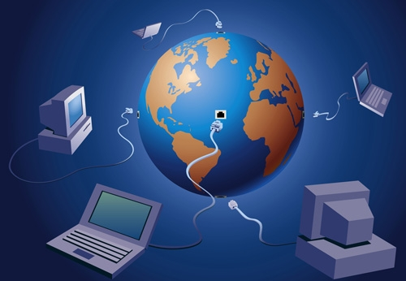
Introduction to the Internet

Slide 2
In This Presentation You Will Learn
Web Pages Vs. Websites
Parts of a Web Address
The names of some important Internet tools
Internet Search Engines

Slide 3
Browser Software
You need a special kind of software to see information on the World Wide Web (WWW).
This kind of software is called browser software.

Slide 4
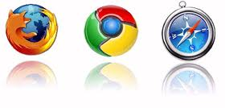
Web Browser
Software program that allows you to view an access resources in the Internet.
At Carlos Rosario School we use Internet Explorer.
Other examples of “Web Browsers” are:
Google Chrome
Firefox
Safari

Slide 5
Web Pages vs. Websites
A page of information on the WWW is called a Web Page.
A collection of web pages is called Website.

Slide 6
Web Address
The address or location of a webpage on the internet is called Web Address.
Important parts of a Web address are:
Hypertext transfer protocol – rules used to access a file
Shows that the Website is on the Web
Domain Name
Extension
The Web Page that you are on

Slide 7
Important Internet Tools
Back button
Favorites Center
History
Refresh button
Home button

Slide 8
Search Engine
It is a Program that help you find information in the World Wide Web.
Google and Yahoo are the most popular search engines.

Slide 9
Internet Review Questions
What is a browser? What is it used for?
What browser do we have on our computers in the class?
Define Web Pages
Define Website
What are the important parts of a Web Address?
Name some important Internet tools
What is a Search Engine? Give examples

Slide 10
1) Is a software that allows you to look for information over the internet
2) Internet Explorer
3) a page of information on the WWW
4) a collection of web pages
5) domain name and extension
6) Back button, Home button, Favorites Center, refresh button, History
7) It is a program that help you to find information in the WWW, for example Google.com, yahoo.com, bing.com

