Slide 1
Introduction to PowerPoint Part 1
By: Janett Arandia

Slide 2
In This Presentation You Will Learn
The names of some important PowerPoint Window elements
How people use PowerPoint
How to present a slide show
Identify different layouts to use on the slide
How to add content to a slide
How to change the slide design

Slide 3
PowerPoint Software
PowerPoint is software that lets you create presentations.
Each PowerPoint presentation is made up of a group of slides.
The abbreviation for PowerPoint is PPT.

Slide 4
How People Use PowerPoint
People use PowerPoint to create slideshow presentations about many topics
business presentations
school presentations
family events

Slide 5
Business people Use PowerPoint
Business people frequently use PowerPoint to make:
Sales presentations
Employee training presentations

Slide 6
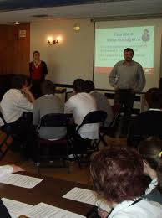
Teachers Use PowerPoint
Teachers use PowerPoint to:
Explain new topics
Give directions

Slide 7
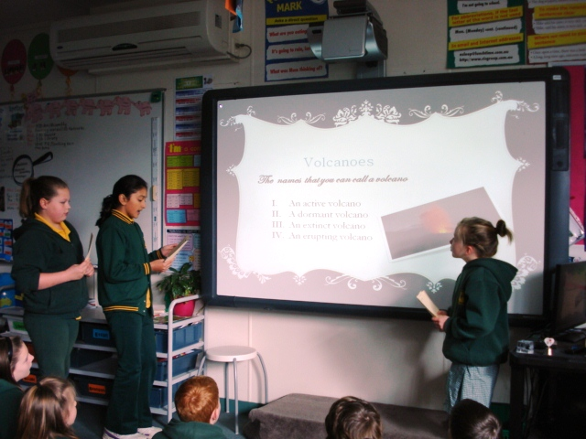
Students Use PowerPoint
Students use PowerPoint to:
Present assignments
Improve writing skills
Improve oral presentation skills

Slide 8
Questions About PowerPoint
What kind of software is PowerPoint?
What do business people use PowerPoint for?
What do students use PowerPoint for?

Slide 9
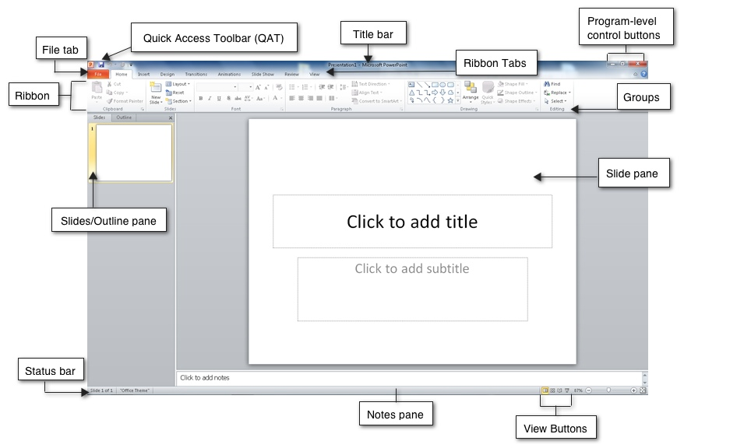
PowerPoint Software
In this section of the presentation you will learn what a PowerPoint window looks like.

Slide 10
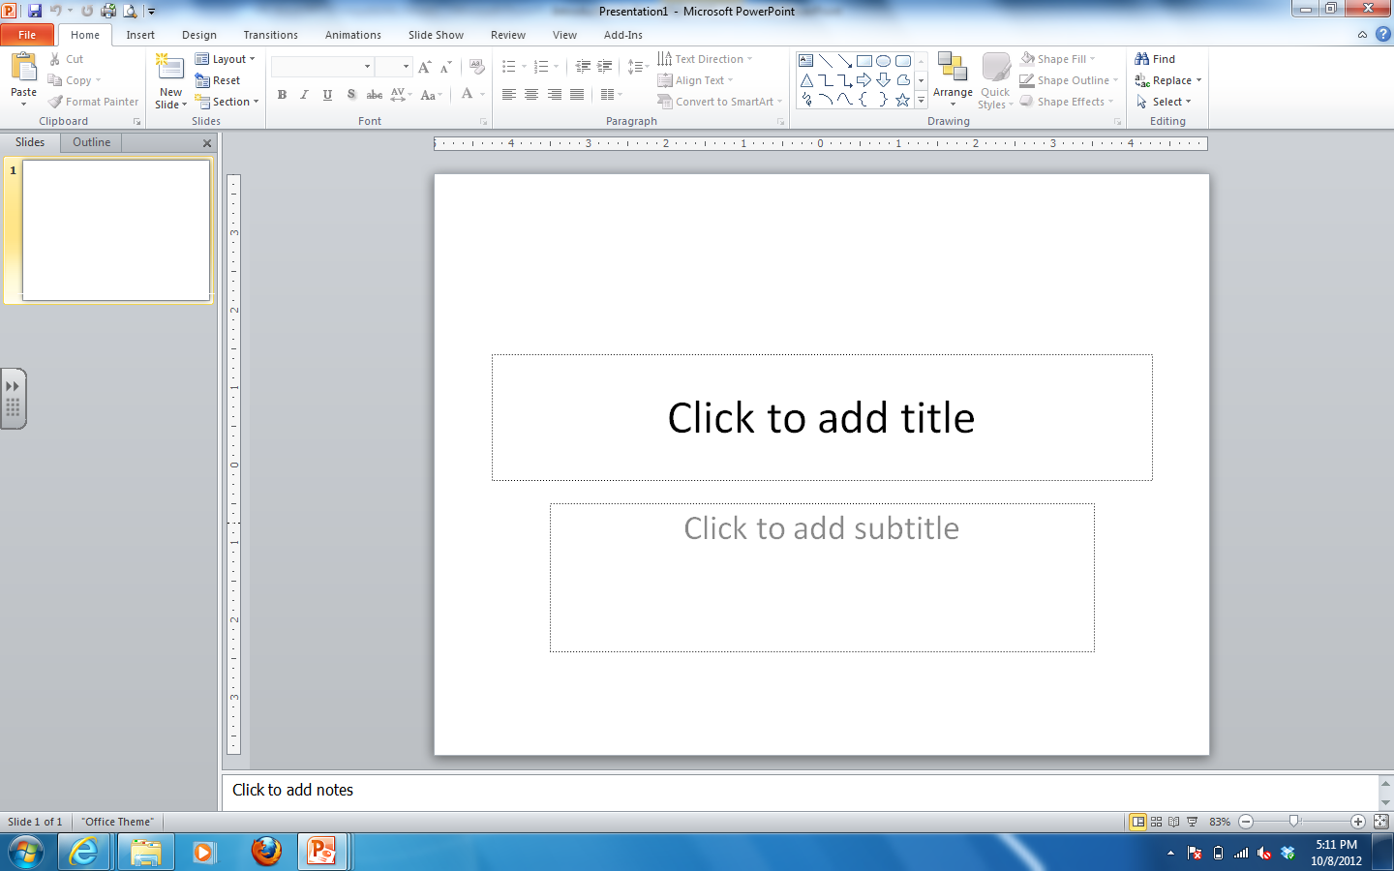
THE POWERPOINT WINDOW
Title bar
After you start PowerPoint, you see a screen such as the one shown here.
The status bar shows information about the presentation, such as the slide number and theme name.
The content box or Placeholder is where you can type or add pictures.
The Notes Pane is where you can type notes to yourself about what you will say about the slide.
The Slides Tab shows all of the slides in your presentation.
The Outline Tab shows an outline of your presentation.
Ribbon
Outline tab
Content Box or Placeholder
Slides tab
Content Box or Placeholder
Status bar
Notes pane
A presentation is a set of slides or handouts that contains information you want to tell an audience.

Slide 11
Questions about the PPT Window
Where is the Content Box or Placeholder?
Where is the Status Bar? What does the Status Bar show?
Where is the Ribbon?
Where are the Slides and Outline tabs? Click on each to see what they show.
Where are the Slide View buttons? Click on each of them to see what they show.
Hit the Slide Show Button on the View button to go back to the Slide Show
Hit the Esc Key on your keyboard to see the PowerPoint Window.

Slide 12
PowerPoint Slides
In this section of the presentation you will learn more about the PowerPoint slides.
Slides are used to organize your presentation by topics!

Slide 13
PowerPoint Slide Layout
In PowerPoint you will see some new tools on the Home Tab Slides Group of the Ribbon:
Layout command – You will use this to change the slide layout
New Slide command – You will use this to add a new slide.

Slide 14
PowerPoint Slide Layout
Slide Layout is the way text, title, content, or other features are located on a slide.
Each slide should include a title, text and other items such as Clip Art or pictures.

Slide 15
The Title Slide
The first slide you make is the Title Slide.
This is the first slide in all presentations because it shows the title and the author.

Slide 16
Content Layout
All the other slides in your presentation should have a title, text and content.
Content means text, pictures or graphs.

Slide 17
Slide Text
Title Placeholder
Content Placeholder
Text are the words and sentences that you type into each slide.
You type the text into the Content Placeholder in each slide.
Text can be formatted.

Slide 18
Slide Pictures & Images
You can also add Images to make your slides more interesting
Clip Art
Pictures from the Internet
Graphs and charts.

Slide 19
Adding Content to Slides
To add content to a slide click one of the six icons:
Table
Chart
Graphic
Picture
Clip Art
Media

Slide 20
Questions About PPT Slides
What does Slide Layout mean?
What should you type on the first slide in a PowerPoint presentation?
What is the title Placeholder?
What does content Placeholder include?

Slide 21
PowerPoint Slide Design
Slide Design is how your slides appear visually with background colors and designs.

Slide 22
Slide Design
Slide Design:
is located on the Design Tab Themes Group of the Ribbon.

Slide 23
Slide Design Themes
Click on the Drop Down menu, you can find the Design Gallery to select the design you like the most for your slide.

Slide 24
Slide Design Background
You can use COLORS as a background for your Slide

Slide 25
Slide Design Background
You can use TEXTURES as a background for your slide

Slide 26
Slide Design Background
You can use PICTURES as a background for your slide

Slide 27
Questions About Slide Design
What is Slide Design?
What can you use as a background for your slides?

Slide 28
Ready to start
Now you are ready to start.
Open the PowerPoint software on your computer.
Look at the elements of the PowerPoint window.
Try to name some of the parts.
Use the Home Tab Slides Group on the Ribbon to add New Slides and change Layouts.

